Slide 1


24GHz-Radar for movement detection
Group number: d3
Members:
Girish Tabaraddi 1119236
Drashti shah 1119295
Ananya harish 1119248

Slide 2

Content
Introduction
Block Diagram
Schematic and PCB design
3D View and Soldered PCB
State Machine
Software Code
Breadboard connections
Hardware Testing
CFAR algorithm

Slide 3
INTRODUCTION:
A 24 GHz radar sensor detects movements and send Doppler frequency to bandpass filter if the movement is detected.
The 4th order Bandpass filter gives Baseband signal as the output which in-turn is send to the ADC.
PSOC samples ADC and FFT data and sends it to MATLAB.
We are using CFAR to set a threshold with which the probability of false alarm reduces.

Slide 4
BLOCK DIAGRAM
RADAR MODULE
Amplifier
Band pass filter
ADC
LED
Detector
CFAR
FFT

Slide 5
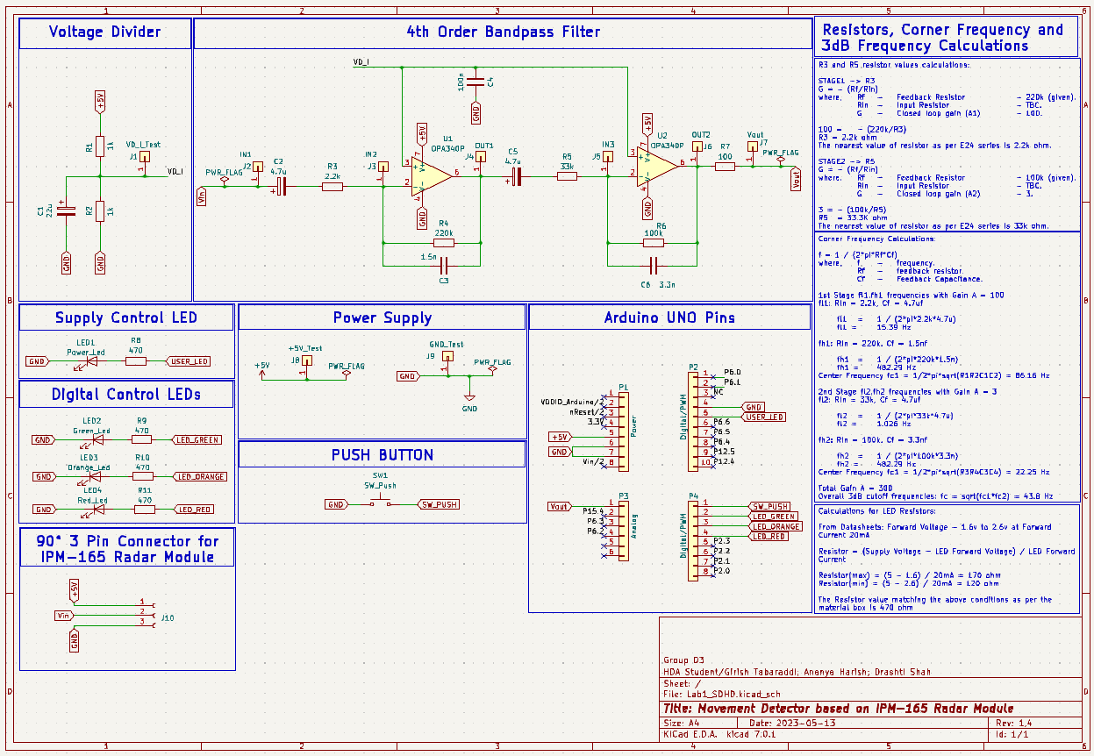
Schematic and pcb design
Fig 1. PCB SCHEMATIC VIEW

Slide 6
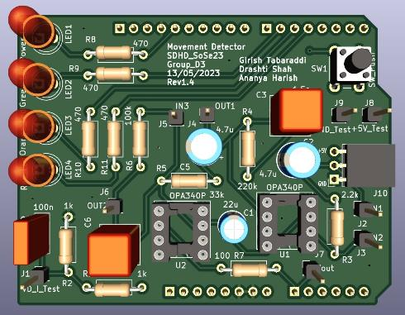
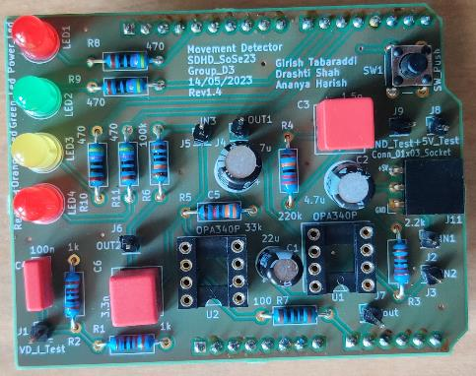
3D view and soldered PCB
Fig 2. PCB 3D VIEW
Fig 3. PCB TOP VIEW

Slide 7
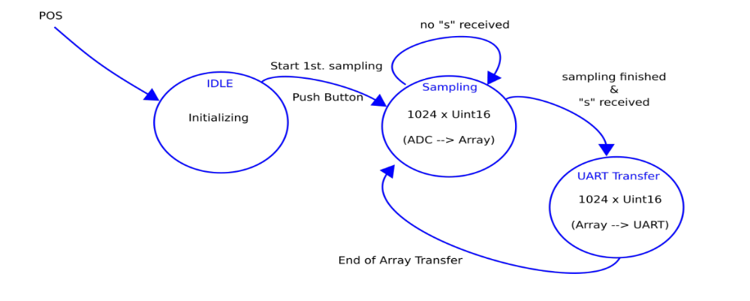
STATE MACHINE
Fig 4. State Machine

Slide 8
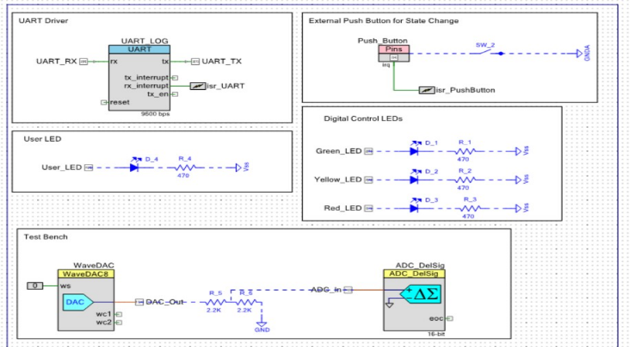
SOFTWARE CODE
Fig 5. TOP DESIGN

Slide 9
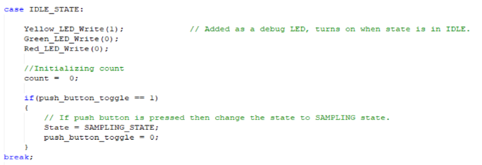
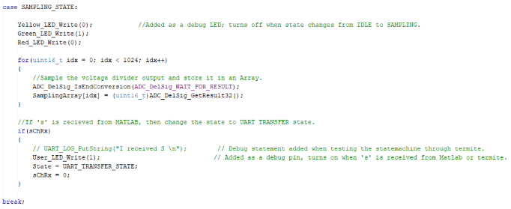
Fig 6. IDLE STATE
Fig 7. SAMPLING STATE

Slide 10
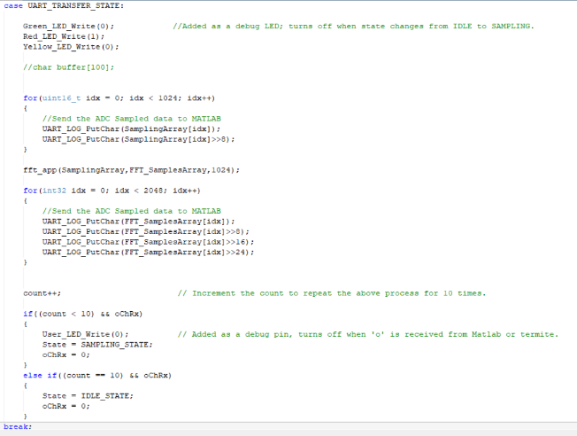
Fig 8. UART TRANSFER STATE

Slide 11
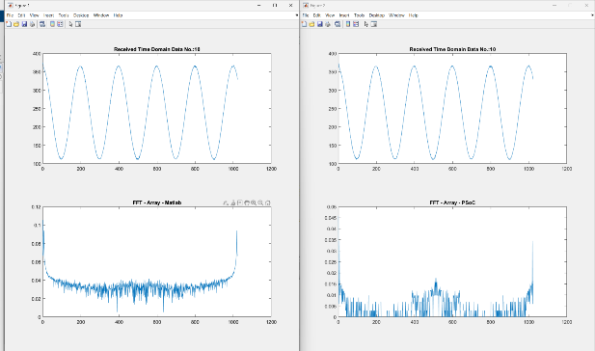
Matlab output
Fig 9. Matlab FFT Output

Slide 12
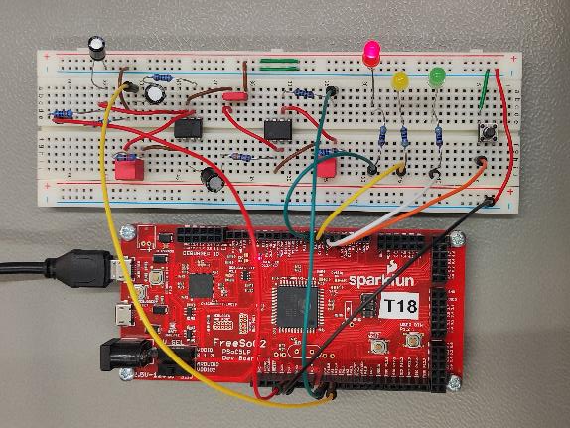
Breadboard connections
Fig 10. 4th Order Bandpass filter

Slide 13
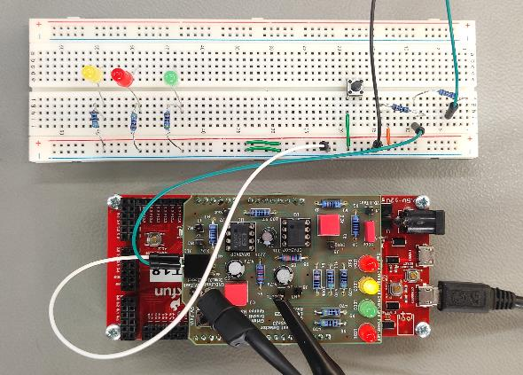
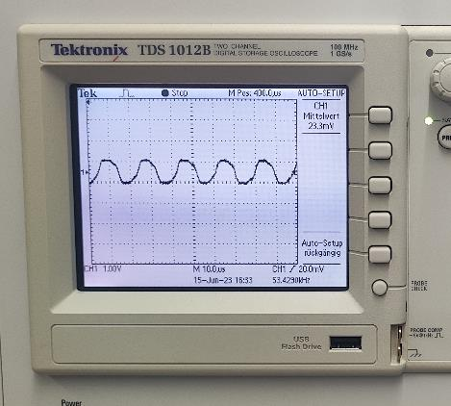
Hardware testing
Fig 11. 1st Stage Circuit
Fig 12. 1st Stage Circuit Output

Slide 14
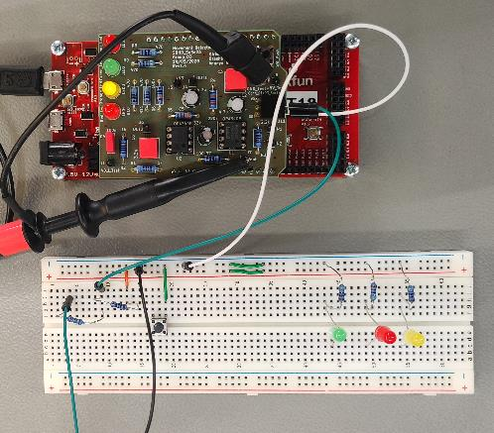
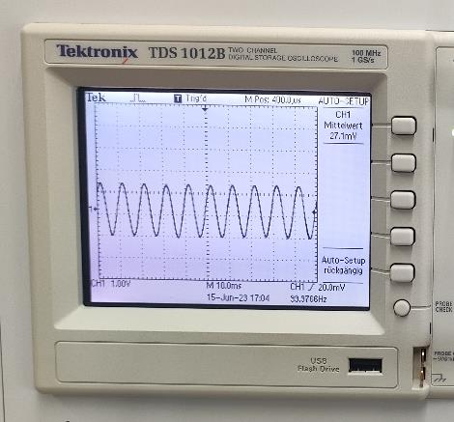
Fig 13. Final PCB Connection
Fig 14. Final Output with Gain 300 dB

Slide 15
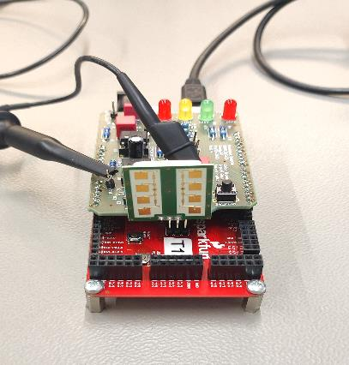
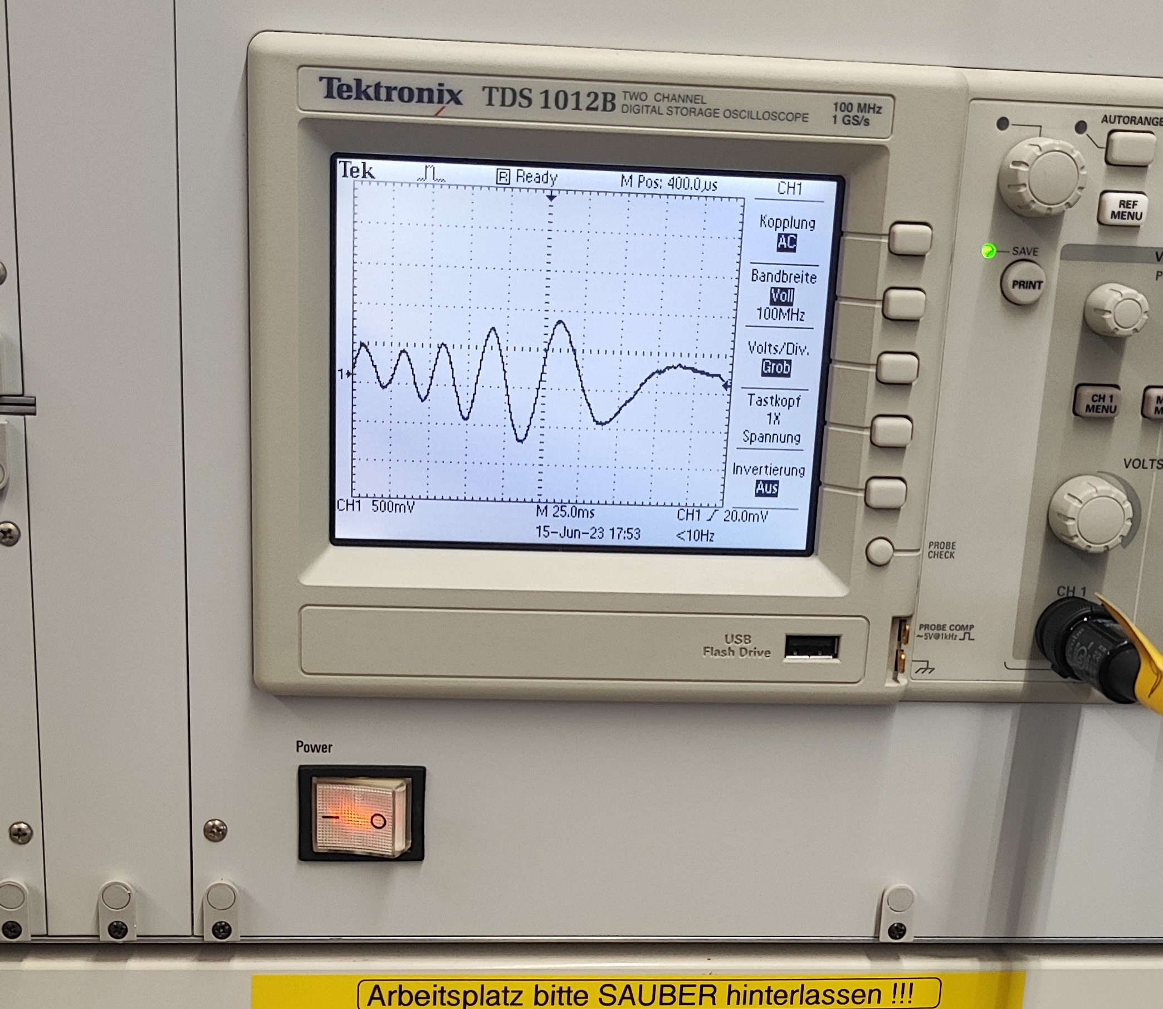
Fig 15. PCB with CW Radar Sensor
Fig 16. Output

Slide 16
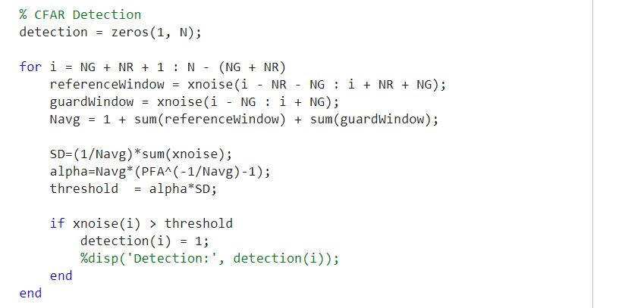
CFAR Algorithm
Fig 17. CFAR Algorithm

Slide 17
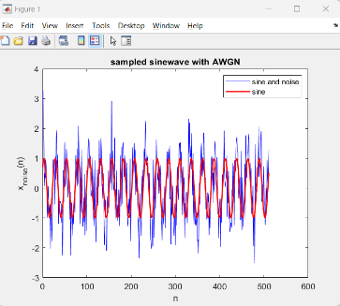
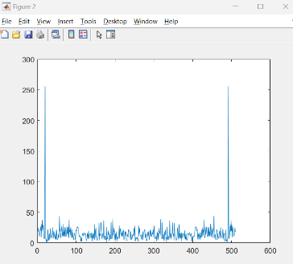
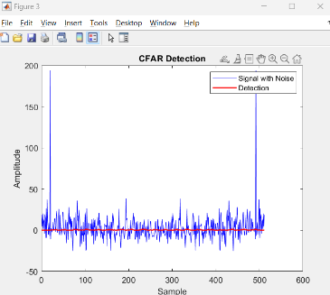
Fig 18. Signal+Noise
Fig 20. FFT of Signal+Noise
Fig 19. CFAR Detection

Slide 18
THANK YOU

